Slide 1

@zinecat #dhpraxis17
Zine Union Catalog
The Digital GC: 2016-2017 Year-End Showcase
Notes:
Title of project and what does this project do?
Add problem statement intro here - Zines are information rich, but across disparate locations and the ZUC will unify these resources into one search platform
Takeaways: 1. Zines are across many collections, but are now searchable in one interface. 2. Struggled for a long time and now have some progress on developing a Union Catalog. 3. Intellectual work of creating a mapping and standardization of messy metadata.

Slide 2
@zinecat #dhpraxis17
Zine Union Catalog Team
Jenna Freedman: Project Director and Community Manager Lauren Kehoe: Metadata Specialist and Documentarian Marti Massana Ferre: Project Manager and Lead Designer Alex Segal: Lead Developer
Notes:
Name team members, but maybe also basics about us--GC timeline and track, work outside GC.
Attendees should see the Zine in their hands-->physicality of a zine
→ Thank you page in the zine
What are zines -- where are they located?? ZUC provides unified location for finding and searching zine collections

Slide 3
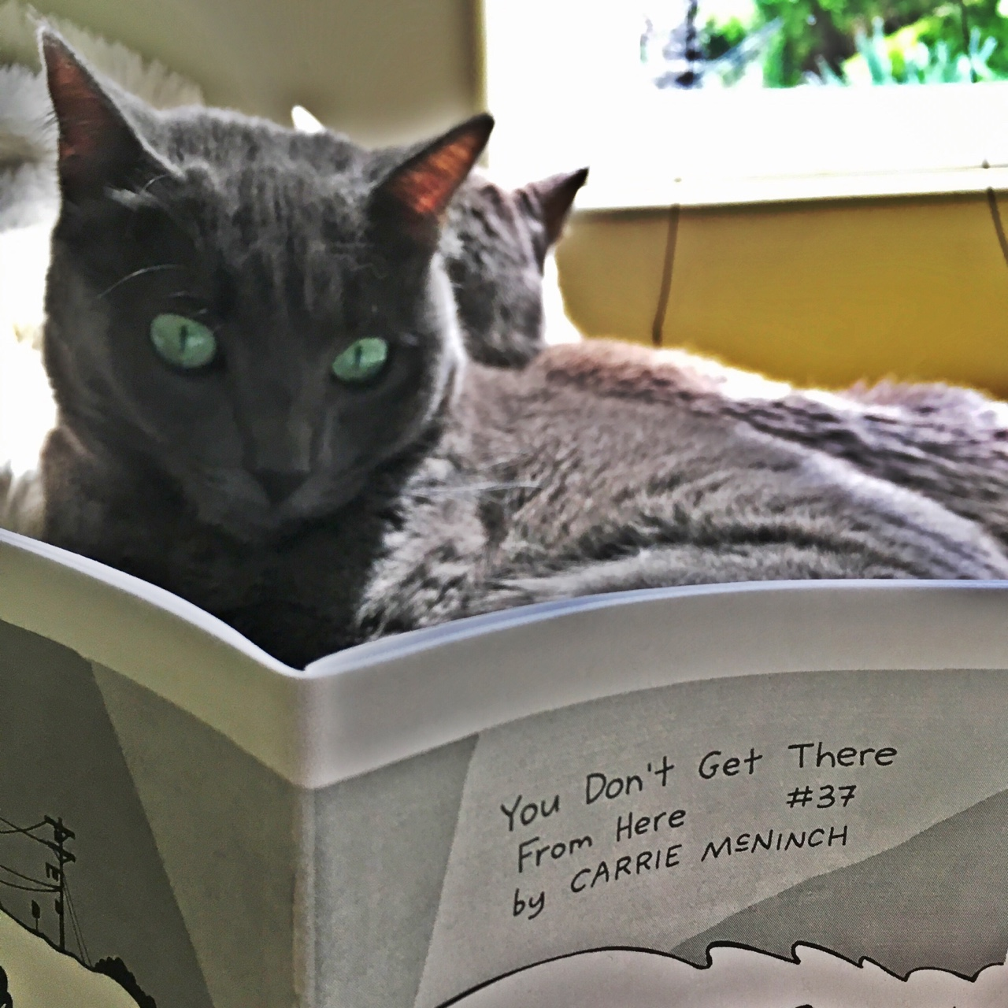
@zinecat #dhpraxis17
It's like a WorldCat or DPLA for zines!
Shared catalog
Why zines matter
Creators
Content
Zine scholars
fine arts, history, media studies, women's studies, education, Black studies, Asian studies, Latinx studies, psychology, library and information science, English literature, and religion
Zine librarians
ZineCat team
Notes:
Jenna Freedman, two classes into MALS DH track.
Why there is a cat on the slide
Zine + cat (and it's reading a zine and probably wondering where to find more zines like it, which is VERY META, and we're all about metadata)
It's like a WorldCat (or Digital Public Library of America) for zines.
Union catalog: one-stop place for finding out about zines & where they're held:
known & unknown item searches, e.g., transgender kids
But why should you care?
Zines are made by people who are otherwise un(der)represented on library shelves due to
age, class, race, gender, sexuality, radical viewpoint
general lack of access to power
Even when these people are on a library shelf, it's usually as the subject of a journalist or scholar's work,
not under their own, unmediated agency.
Zinesters write for a peer audience
about political and social issues like racial justice, personal concerns like mental health and self-injury
share instructions on a range of topics including herbal remedies for menstrual cramps and home greywater reclamation.
People who want to locate zines--that I've personally hosted at my library--
[list on slide]
journalists in across multiple media platforms.
as well as leisure zine readers, like a woman who lost her zine collection as a teen when she came out to her parents and was kicked out of their house
Zine librarians from across North America discussing the idea since 2009, including conference calls for the last few years, but we didn't have much tangible to show for it until now.
The zine cat project team has managed, in two months, to sketch a proof of concept of the zine union catalog.
Here is our developer Alex Segal to introduce you...

Slide 4
@zinecat #dhpraxis17
Zine Union Catalog
Zines are important and potentially valuable to researchers and general users.
Disparate collections Finding material is difficult.
What are the challenges for bringing these collections together?
Disparate collections means: non-standardized data
Notes:
As you now know, various institutions have collections of zines that may be of interest to researchers and the general public. But, some of these institutions can be small and hard to find.
So, why not have one place where a user can search multiple collections at the same time?
Well.. There are some major obstacles. One main issues is that different collections follow their own standards for how to catalog their materials.
Using the work done by zine librarians, the Zine Union Catalog sets out to tackle this issue.

Slide 5
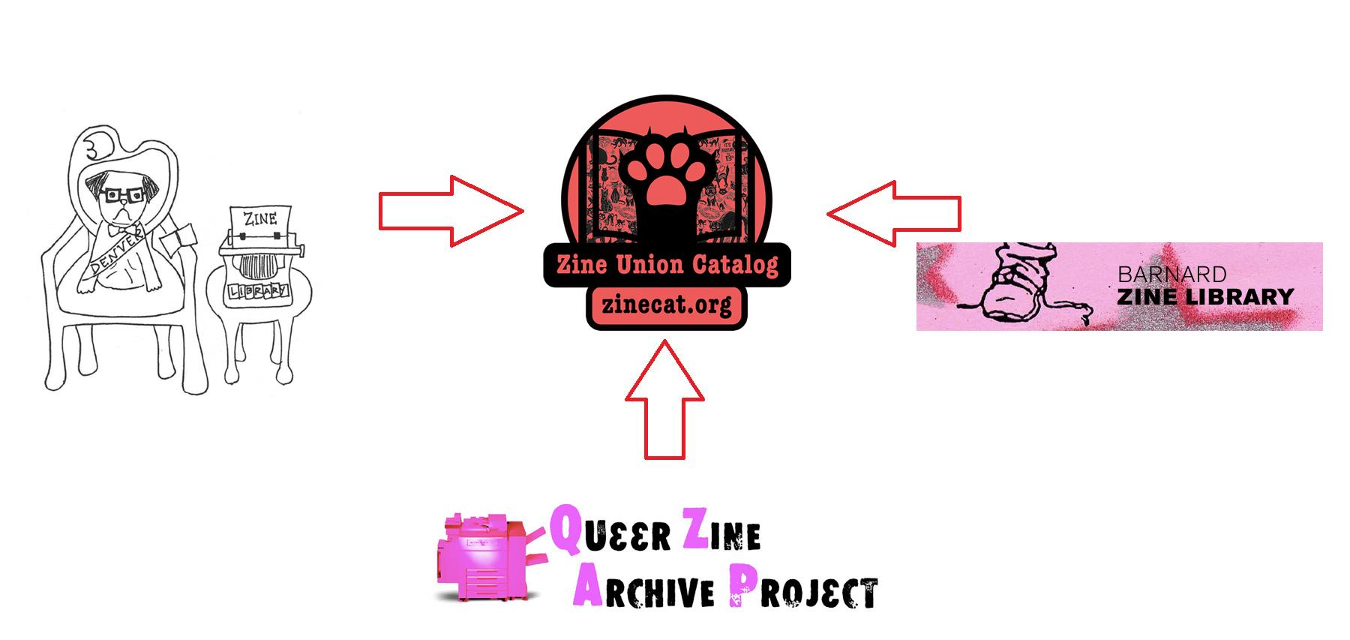
The ZineCat Prototype
Notes:
The ZineCat prototype takes sample metadata from three different collections.
Denver Zine Library, Barnard Zine Library
And the Queer Zine Archival Project, a catalog built with the xZINECOREx mapping schema that Zine Cat uses.

Slide 6
@zinecat #dhpraxis17
Using Collective Access
We have created a single map that creates a representation of records consisting of:
Title
Author
Format of object (physical zine, audio zine, etc.)
Date Created
Location Created
Related Collection
External URL
Notes:
Zine Cat was built using Collective Access - an open-source content management system that can be used for private and public-facing collections.
Collective Access allowed us to design a mapping schema that would make it easy to normalize data. Our current schema only includes the most essential fields - title, author, details about where and when it was created, and details about the source collection.
All that needs to be done to participate in ZineCat is to export metadata according to our mapping schema

Slide 7
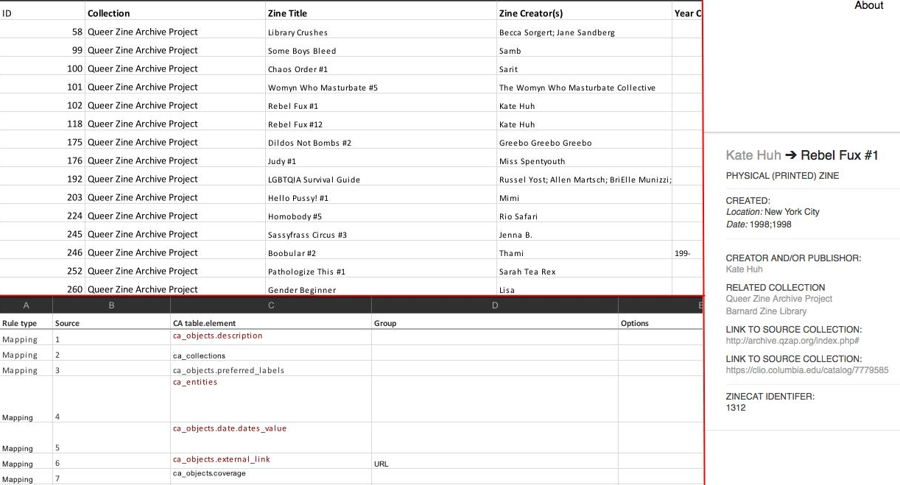
Notes:
TOP: Sample metadata from Queer Zine Archive Collection
BOTTOM: Our mapping schema
RIGHT: What you see on the Zine Union Catalog

Slide 8
Notes:
TOP: Sample metadata from Queer Zine Archive Collection
BOTTOM: Our mapping schema
RIGHT: What you see on the Zine Union Catalog
If you look at authors, Kate Huh for example….

Slide 9
Notes:
TOP: Sample metadata from Queer Zine Archive Collection
BOTTOM: Our mapping schema
RIGHT: What you see on the Zine Union Catalog
The mapping schema we’ve created has a field for this. It turns the content of a particular column in the metadata into an authoritative field.

Slide 10
Notes:
TOP: Sample metadata from Queer Zine Archive Collection
BOTTOM: Our mapping schema
RIGHT: What you see on the Zine Union Catalog
This mapping schema imports the zine along with its details, and treats the creator and the collection as independent elements that exist in relationship to one another.

Slide 11
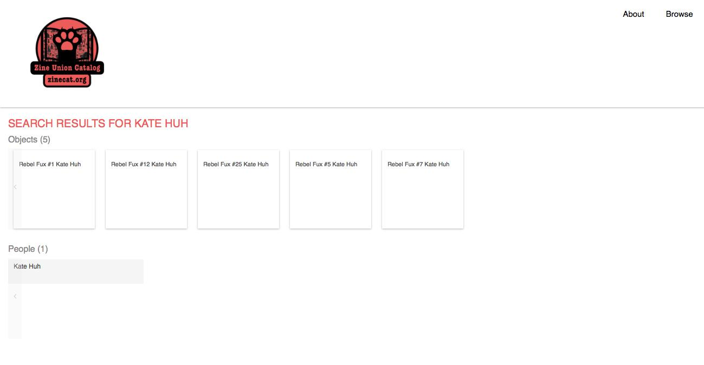
@zinecat #dhpraxis17
Creator/Publisher Search Results Page
Notes:
You can click on the entity to find all the information relevant to this creator. You can search author names, collection names, etc.
But, most importantly, multiple collections that hold the same zine will create a single page for that zine, with the related collections listed.

Slide 12
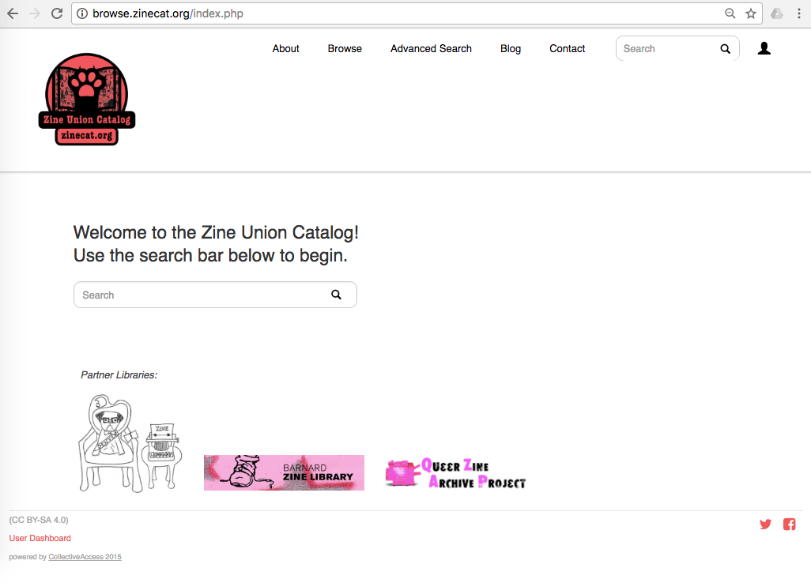
@zinecat #dhpraxis17
And now for a live demo…
Notes:
Bullet point , Piloted three collections and it will grow Screenshots & other images okay, too!
Slow down and explain what different fields are. Articulate more. What is an entity??
Add more, let’s say you want to do X...tell a story. “Let’s say you wanted to do research on Queer Zines, where do they exist?” Here’s what you want to do.
Primary features of search (search by library, entity, creator)
Lead with why searching this catalog matters
Zine librarians demand a need for the ZUC
Development of catalog → CA: open source cms (give nod to QZAP??)
Back end & front end for repositories for institutions (libraries/archives) to represent their collections digitally
ZUC unique → CMS used by Multiple collections and represent multiple holdings in one location → challenge. Other CA users have not used CA in this way.
Simplified mechanisms of ingest → MAP!! Collections, entities, links, dates → mapped to fields in metadata CSV files
Translates into User Interface of CA and searching for a zine
Live search
By title, creator, (keyword)
Collections, objects
Catalog fields
Log in to create a collection
Browse
End on the blog

Slide 13
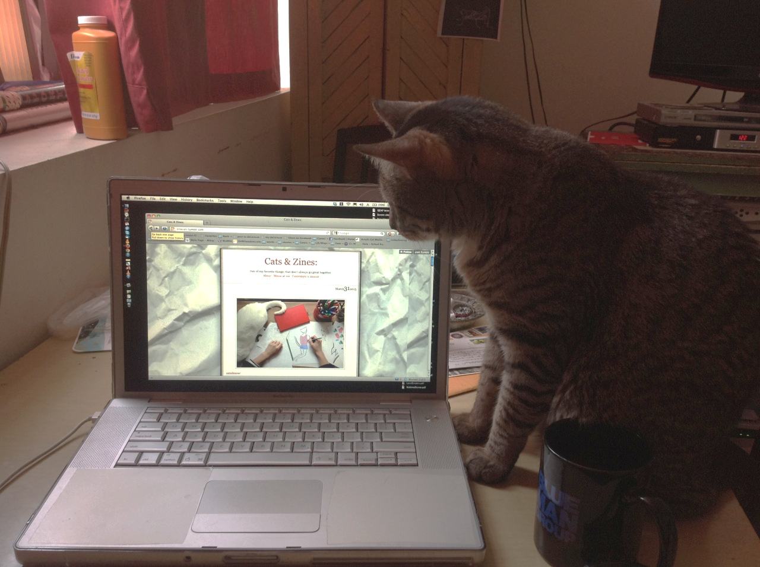
@zinecat #dhpraxis17
Next Steps
More records
More libraries
More fields
Mutual metadata (that's anarchist for "authority control")
Maybe some money
Notes:
Add more records from current three collections and from more libraries.
We have records ready to upload in our GitHub repository from, among others
ABC No Rio, with a standalone database with a standalone metadata schema
Carnegie Library of Pittsburgh, which has been using LibraryThing as its catalog
Minneapolis Community and Technical College with another standalone catalog that uses ZINECORE
Ontario College of Art & Design with its records currently hosted on ARTstor
More sophisticated use of mutual metadata
Establishing authority files for creators
Subject thesaurus
leveraging linked open data--all about relationships now, and CA's strength is drawing out such relationships.
Zine Librarians group and ZineCat Group are in one email list-->working together
NEH DH Advancement Grant→to fund an in-person meeting to tease out points of unity (i.e, standardization) in cataloging while allowing each library or archive to maintain its unique identity.
Try us out...

Slide 14
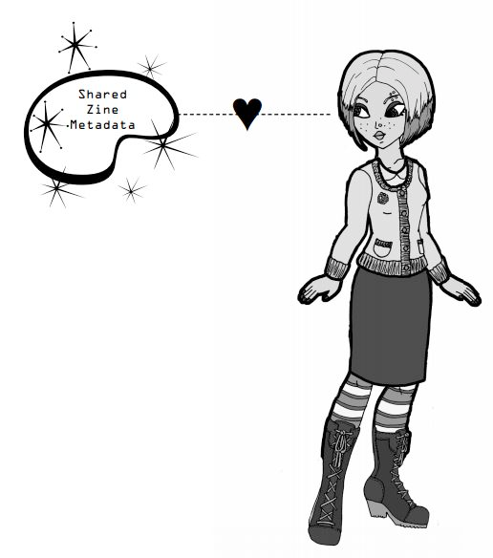
@zinecat #dhpraxis17
Credits & Links
Website zinecat.org
Email zinecatproject@gmail.com
Repository github.com/MiloQZAP/xZINECOREx
Collective Access collectiveaccess.org
Participating libraries
Barnard Zine Library zines.barnard.edu
Denver Zine Library denverzinelibrary.org
Queer Zine Archive Project qzap.org
Zine Union Catalog on zinelibraries.info zinelibraries.info/zine-union-catalog
Cat photos zinecats.tumblr.com

